Slide 1
MODULE – 1 Portion 2
Classes, objects, methods and Constructors
[Lecture:8 & Practical:4]

Slide 2
Contents
Object Oriented Concepts
Classes and Objects
Adding Methods to the class
Adding Parameter to the methods
Activity

Slide 3
Object Oriented Concepts
Object
Encapsulation
CLASS
Data Abstraction
Object Oriented Concepts
Inheritance
Polymorphism

Slide 4
Object Oriented Concepts
Class - is a user defined blueprint or prototype from which objects are created. It represents the set of properties or methods that are common to all objects of one type.
Object - is a basic unit of Object Oriented Programming and represents the real life entities. A typical Java program creates many objects, which interact by invoking methods.
Data Abstraction - is the property by virtue of which only the essential details are displayed to the user. The trivial or the non-essentials units are not displayed to the user. Ex: A car is viewed as a car rather than its individual components.

Slide 5
Object Oriented Concepts
Encapsulation - It is defined as the wrapping up of data under a single unit. It is the mechanism that binds together code and the data it manipulates. Another way to think about encapsulation is, it is a protective shield that prevents the data from being accessed by the code outside this shield.
Polymorphism- It refers to the ability of OOPs programming languages to differentiate between entities with the same name efficiently. This is done by Java with the help of the signature and declaration of these entities.
Inheritance - is an important pillar of OOP(Object Oriented Programming). It is the mechanism in java by which one class is allow to inherit the features(fields and methods) of another class.

Slide 6



Classes and Objects
Encapsulation
A Java program consists of one or more classes
A class is an abstract description of objects
Here is an example class:
class Dog { ...description of a dog goes here... }
Here are some objects of that class:
Syntax to declare a class:
class <class_name>
{
field;
method;
}

Slide 7
Classes contain data definitions
Classes, Objects and Methods
Classes describe the data held by each of its objects
Example:
class Dog { String name; int age; ...rest of the class... }
Data usually goes first in a class
A class may describe any number of objects
Examples: "Fido", 3; "Rover", 5; "Spot", 3;
A class may describe a single object, or even no objects at all

Slide 8
Activity
Q1. Mr. John has joined a Company as Database Administrator and his major role is to maintain the Employee database which includes Employee Id, Name, Age and Salary.

Slide 9
Classes contain methods
Classes, Objects and Methods
A class may contain methods that describe the behavior of objects
A method must be declared within a class. It is defined with the name of the method, followed by parentheses ().
Java provides some pre-defined methods, such as System.out.println(), but you can also create your own methods to perform certain actions:
When we ask a particular Dog to bark, it says “Woof!”
Only Dog objects can bark; the class Dog cannot bark
Example:
class Dog { ... void bark() { System.out.println("Woof!"); } }
Methods usually go after the data

Slide 10
Methods contain statements and Parameters
Classes, Objects and Methods
A statement causes the object to do something
(A better word would be “command”—but it isn’t)
Example:
System.out.println("Woof!");
This causes the particular Dog to “print” (actually, display on the screen) the characters Woof!
Example:
void wakeTheNeighbors( ) { int i = 50; // i is a temporary variable while (i > 0) { bark( ); i = i – 1; } }
Data described in a class exists in all objects of that class
Example: Every Dog has its own name and age
A method may contain local temporary data that exists only until the method finishes(either as parameter or with in its body)

Slide 11
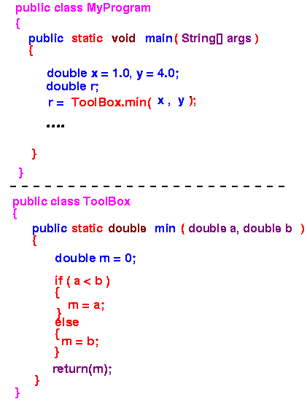
Classes, Objects and Methods
Parameters
Actual Parameters
Formal Parameters
Actual Parameters
Formal Parameters

Slide 12
Activity
Q1. Mr. John has joined a Company as Database Administrator and his major role is to maintain the Employee database which includes Employee Id, Name, Age and Salary. Help Mr. John to read/store the records and retrieve all the records which he has stored.

Slide 13
Contents
Method overloading
Activity on Method overloading
Access Specifiers
Adding Constructors to the class
Activity on Constructors

Slide 14
Methods can be overloaded
Classes, Objects and Methods
Method overloading is a feature of Java in which a class has more than one method of the same name and their parameters are different
Example
class CalculateSquare {
void square() {
System.out.println("No Parameter Method Called");
}
int square( int number ) {
int square = number * number;
System.out.println("Method with Integer Argument Called:"+square);
}
float square( float number ) {
float square = number * number;
System.out.println("Method with float Argument Called:"+square);
}
}
Overloading

Slide 15
Activity
Q1. Mr. John has joined a Company as Database Administrator and his major role is to maintain the Employee database which includes Employee Id, Name, Age and Salary. He has given a freedom to read/store the data in the database as shown below:
Read all the data by taking values from the user.
Read only Employee Id from the user and store some default values as he likes to name, age and Salary.
Read Employee Id and Name from the user and store some default values as he likes to age and Salary. Help Mr. John to store the records and retrieve all the records which he has stored.

Slide 16
Classes, Objects and Methods
PACKAGE 1
Subclass
Class two
ACESS SPECIFIERS
Class one{
int d;
private int a;
public int b;
protected int c;
}
ACESS SPECIFIERS
d
a
b
c
PUBLIC
The access level of a public modifier is everywhere. It can be accessed from within the class, outside the class, within the package and outside the package.
Class three
d
a
b
c
The access level of a protected modifier is within the package and outside the package through child class. If you do not make the child class, it cannot be accessed from outside the package.
PROTECTED
PACKAGE 2
PRIVATE
The access level of a private modifier is only within the class. It cannot be accessed from outside the class.
Class four
Subclass
d
a
c
b
DEFAULT
The access level of a default modifier is only within the package. It cannot be accessed from outside the package.
If you do not specify any access level, it will be the default.
Class five
d
a
b
c

Slide 17
Classes can contain constructors
Classes, Objects and Methods
In Java, a constructor is a block of codes similar to the method.
It is called when an instance of the class is created.
At the time of calling constructor, memory for the object is allocated in the memory.
Every time an object is created using the new keyword, at least one constructor is called.
If you don’t write a constructor, Java defines one for you (behind the scenes), i.e. It calls a default constructor if there is no constructor available in the class. In such case, Java compiler provides a default constructor by default.
You can write your own constructors

Slide 18
Classes can contain constructors
Classes, Objects and Methods
Rules for creating Java constructor
Constructor name must be the same as its class name
A Constructor must have no explicit return type
Types of constructors
Default constructor (no-arg constructor)
Parameterized constructor
Example: class Dog { String name; int age; Dog(String n, int a) { name = n; age = a; } }
(This part is the constructor)

Slide 19
Activity
Q1. Mr. John has joined a Company as Database Administrator and his major role is to maintain the Employee database which includes Employee Id, Name, Age and Salary. He also been permitted to generate some default values to the Employee data fields before adding employee records to the database. Help Mr. John to store the records and retrieve all the records which he has stored.

Slide 20
Contents
Constructor overloading
Activity on Constructor overloading
Review of Program structure
Complete program demonstration

Slide 21
Constructors can be overloaded
Classes, Objects and Methods
Example:
class Student5 {
int id;
String name;
int age;
Student5(int i, String n) {
id = i;
name = n;
}
Student5(int i, String n, int a) {
id = i;
name = n;
age=a;
}
void display() {
System.out.println(id+" "+name+" "+age);
} }
Constructor overloading in Java is a technique of having more than one constructor with different parameter lists.
They are arranged in a way that each constructor performs a different task.
They are differentiated by the compiler by the number of parameters in the list and their types.
A constructor is just like a method but without return type. It can also be overloaded like Java methods.
Overloading

Slide 22
Activity
Q1. Mr. John has joined a Company as Database Administrator and his major role is to maintain the Employee database which includes Employee Id, Name, Age and Salary. He also been constrained to generate some default values to the Employee data fields before adding employee records to the database in the following fashion:
With default values as EmpId=123, Name=“PC-06”, Age=1 and Salary=20000.00.
With default values taken from user as parameters.
By copying already created employee record.
Help Mr. John to store the records and retrieve all the records which he has stored.

Slide 23
Diagram of program structure
Classes, Objects and Methods
Program
File
File
File
Class
Variables
Constructors
Variables
File
Statements
Methods
Variables
A program consists of one or more classes
Typically, each class is in a separate .java file
Statements

Slide 24
A complete program
Classes, Objects and Methods
class Dog { String name; int age; Dog(String n, int a) { name = n; age = a; } void bark() { System.out.println("Woof!"); }
void wakeTheNeighbors( ) { int i = 50; while (i > 0) { bark( ); i = i – 1; } } public static void main(String[ ] args) {
}
} // ends the class
//Instantiate an object
// Access the Members of Class

Slide 25
Contents
Objects Creation/Instantiation
Accessing the Members of the class using object reference
Classes and objects summary
Why to use This keyword - Problem statement

Slide 26
Object Instantiation
Classes, Objects and Methods
Declaration
Declaring a variable that associate a variable name with an object type.
Ex: Dog D1;
Instantiation
The new keyword is a Java operator that creates the object.
Ex: Dog D1=new Dog();
Initialization
The new operator is followed by a call to a constructor, which initializes the new object.
Ex: Dog D1=new Dog(“Fido”,5);
public static void main(String[ ] args) {
}
} // ends the class
//Instantiate an object
// Access the Members of Class
public static void main(String[ ] args) {
}
} // ends the class
Dog fido = new Dog("Fido", 5);
// Access the Members of Class
Syntax:
Classname ObjectName=new Constructor(parameters);

Slide 27
Accessing Members through objects
Classes, Objects and Methods
Once object is created, we want to use it for something like we may need to use the value of one of its fields, change one of its fields, or call one of its methods to perform an action.
Code that is outside the object's class must use an object reference or expression, followed by the dot (.) operator, followed by a simple field name, as in:
public static void main(String[ ] args) {
}
} // ends the class
//Instantiate an object
// Access the Members of Class
public static void main(String[ ] args) {
}
} // ends the class
Dog fido = new Dog("Fido", 5);
fido.wakeTheNeighbors();
ObjectName . Members(fields) of the class;

Slide 28
Classes, Objects and Methods
Class | Object
It is Conceptual & Independent Entity | It is physical(having existence) and dependent Entity
It is a Blue print to object. | Without Class object can’t be created
It consists of Attributes and Behaviors | It is a instance of Attributes and Behaviors defined for a Class
Programmatically it is a user defined Data type. | Programmatically it is a variable to a class type data type
E. g : Student, Employee | E. g: amit as student, ankit as Employee

Slide 29

Problem statement
this keyword
Check is it possible to use the local and instance variable with same name or not in the given example.
Problem associated with this is called “Instance variable Hiding”.
Reason is, the local or formal parameter hides the meaning of instance variable thus causes compiler to be in panic mode.
The Solution to this problem is the use of this keyword.
class Dog { String name; int age; Dog(String name, int age) { name = name; age = age; } void bark() { System.out.println("Woof!"); }

Slide 30
Contents
This keyword
Activity on this keyword
Static keyword
Activity on static keyword

Slide 31
Solution
this keyword
this is the java keyword.
This keyword always refers to the current object on which the method is called.
class Dog { String name; int age; Dog(String name, int age) { this.name = name; this.age = age; } void bark() { System.out.println("Woof!"); }
public static void main(String[ ] args) { Dog fido = new Dog("Fido", 5);
fido.wakeTheNeighbors();
}
Current object

Slide 32
Activity
Q1. Mr. John has joined a Company as Database Administrator and his major role is to maintain the Employee database which includes Employee Id, Name, Age and Salary. Help Mr. John to store the records and retrieve all the records which he has stored:
Modify the above program using “this keyword”

Slide 33
static keyword
The static keyword in Java is used for memory management mainly.
We can apply static keyword with variables, methods, blocks and nested classes.
The static keyword belongs to the class than an instance of the class.
The static can be:
Variable (also known as a class variable)
If you declare any variable as static, it is known as a static variable.
The static variable can be used to refer to the common property of all objects (which is not unique for each object), for example, the company name of employees, college name of students, etc.
The static variable gets memory only once in the class area at the time of class loading.

Slide 34
Java static keyword
The static can be:
Block(also known as a class method)
A static block (also called static clause) that can be used for static initializations of a class
static block and static variables are executed in order they are present in a program
static blocks are automatically called as soon as class is loaded in memory and there is nothing to do as we have to in case of calling methods and constructors inside main()
Method (also known as a class method)
If you apply static keyword with any method, it is known as static method.
A static method belongs to the class rather than the object of a class.
A static method can be invoked without the need for creating an instance of a class.
A static method can access static data member and can change the value of it.

Slide 35
Activity
Q1. Mr. John has joined a Company as Database Administrator and his major role is to maintain the Employee database which includes Employee Id, Name, Age and Salary.
Help Mr. John to display the “total salary expenditure” required for all the employees of the company in a month.

Slide 36
Contents
Nested class
Static Nested Class
Non Static Nested Class/Inner class

Slide 37
Nested Class
Nested Class
Static Nested Class
Inner Class
Non-Static Inner Class
Anonymous Inner Class
Local Inner Class
Notes:
Source: 1. Anonymous: https://www.geeksforgeeks.org/anonymous-inner-class-java/
2. Local: https://www.geeksforgeeks.org/local-inner-class-java/

Slide 38
Nested Class
class Outer
{
}
//instance variable
int x=20;
//static variable
static int y=20;
Since non-static members and inner class both are strongly associated with outer class object. Without the object of outer class, non-static members and inner class does not exists.
//inner class
class inner
{
}
Since static members and static nested class both are not strongly associated with outer class object. Without the object of outer class, static members and static nested class can exists.
//static nested class
static class nested
{
}
Notes:
Source: 1. https://scientecheasy.medium.com/static-nested-class-in-java-15e60401db71
2. https://www.javaskool.com/java-inner-class/

Slide 39
Nested Class
class Outer
{
}
Outer class/Top-level class
static members
Both static and non-static members of a static nested class can access static members of its outer class.
non-static members
static nested class cannot have non static members.
static class Nested
{
}
A normal inner class can access any members of its outer class, regardless of their access modifiers.
static members
non-static members
A non-static nested class cannot have static members.
class Inner
{
}
A normal inner class can access static members of any static nested classes within the same outer class
non-static members

Slide 40
Comparison
Nested Class
S.NO | Normal/Regular inner class | Static nested class
1. | Without an outer class object existing, there cannot be an inner class object. That is, the inner class object is always associated with the outer class object. | Without an outer class object existing, there may be a static nested class object. That is, static nested class object is not associated with the outer class object.
2. | Inside normal/regular inner class, static members can’t be declared. | Inside static nested class, static members can be declared.
3. | As main() method can’t be declared, regular inner class can’t be invoked directly from the command prompt. | As main() method can be declared, the static nested class can be invoked directly from the command prompt.
4. | Both static and non static members of outer class can be accessed directly. | Only a static member of outer class can be accessed directly.

Slide 41
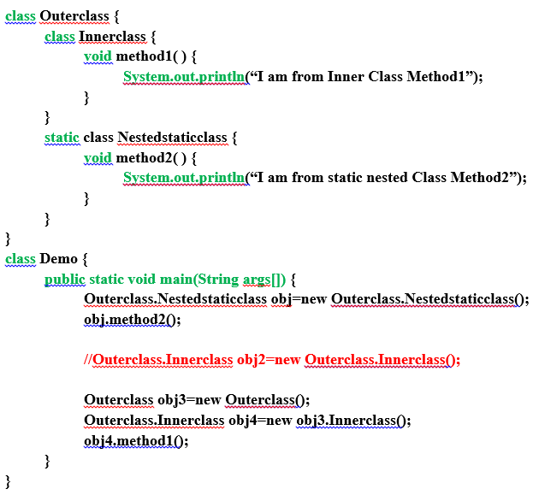
Example
Nested Class
Inner class
Static class
Compilation Error

Slide 42
Module – 1 Completed

